Slide 1
Single Dimensional Array
QuyenNV

Slide 2
INTRODUCTION
Suppose you have wanted to arrange the marks of your classmates in ascending order.
Let there are 60 students in your class. To get this goal, you have two options
1) Construct 60 variable and use them to short, the marks in the ascending order.
2) Create an array of 60 items and use them. To access the different marks we have to only change the index. Of course, the second approach is more convenient than the first approach. Now, we will see the concept of an array in C
An array is an important part of almost all programming languages. It provides a powerful feature and can be used as such or can be used to form complex data structure like stacks and queues. An array can be defined as an infinite collection of homogeneous or same type elements. This means that an array can store all integers, all floating point numbers, all characters (array of character or strings) or any other complex data type, but all of the same type.

Slide 3
DEFINE AN ARRAY
Declaring an array variable, creating an array, and assigning the reference of the array to the variable can be combined in one statement as:
elementType[] arrayRefVar = new elementType[arraySize];
Or
elementType arrayRefVar[] = new elementType[arraySize];
Here is an example of such a statement:
double[] myList = new double[10];
This statement declares an array variable, myList, creates an array of ten elements of double type, and assigns its reference to myList. To assign values to the elements, use the syntax:
arrayRefVar[index] = value;
For example, the following code initializes the array.
myList[0] = 5.6;
myList[1] = 4.5;
myList[2] = 3.3;

Slide 4
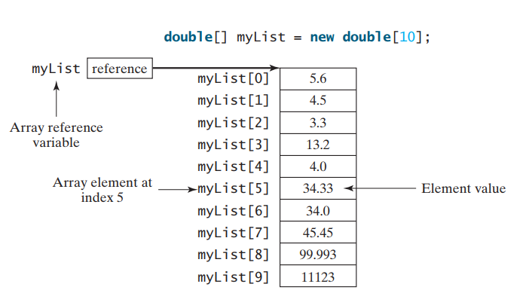
DEFINE AN ARRAY

Slide 5
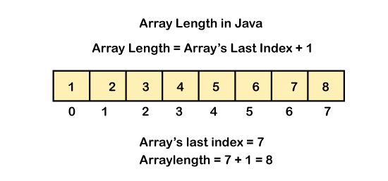
ARRAY LENGTH

Slide 6
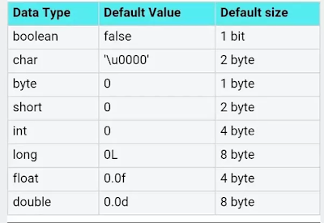
ARRAY SIZE IN BYTE
The total size of an array in bytes can be computed as:
Size in bytes = Size of array * size of base type
Therefore, what is the meaning of the size of an array? size of the array means the number of elements that array can store base types means and type of elements that array stores such as float, integer, character.
To understand, suppose that if the declaration of an array looks like as following:
float a[10];
Furthermore, total memory in a byte that array would occupy will be given by:
size of array = 10 x (size of float)
= 10 x 4
= 40

Slide 7
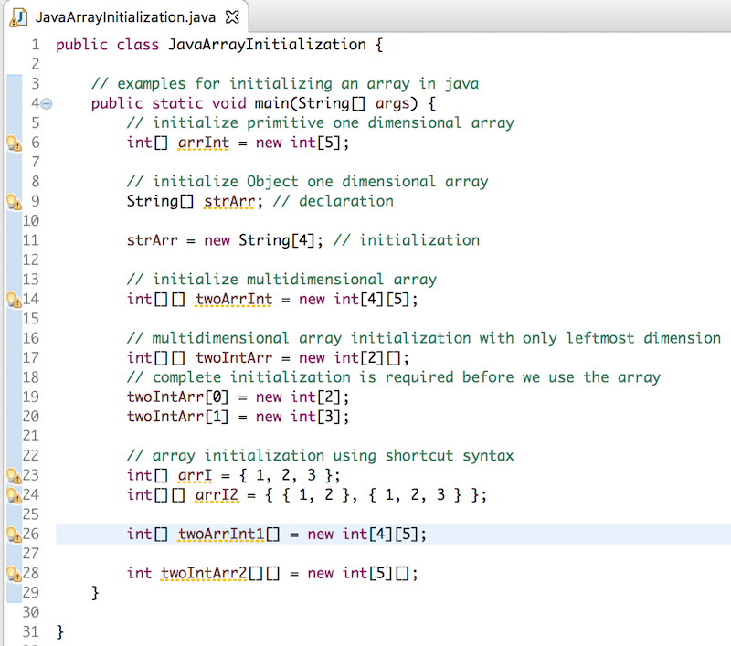
ARRAY INITIALIZERS
Notes:
public static void main(String[] args) {
double[] myList = {1.9, 2.9, 3.4, 3.5};
// Print all the array elements
for (int i = 0; i < myList.length; i++) {
System.out.println(myList[i] + " ");
}
// Summing all elements
double total = 0;
for (int i = 0; i < myList.length; i++) {
total += myList[i];
}
System.out.println("Total is " + total);
// Finding the largest element
double max = myList[0];
for (int i = 1; i < myList.length; i++) {
if (myList[i] > max) max = myList[i];
}
System.out.println("Max is " + max);
}

Slide 8
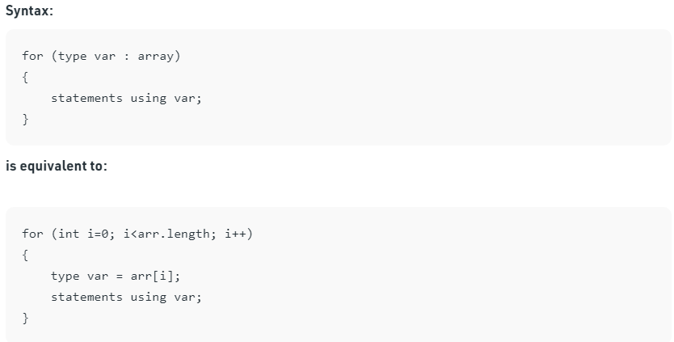
FOREACH LOOPS

Slide 9
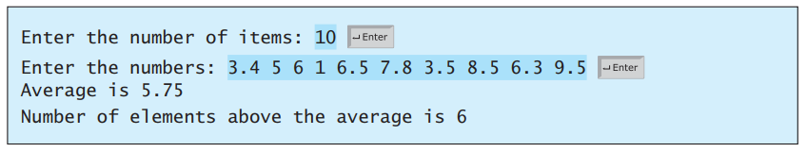
Case study: Analyze Numbers
Now you may write a program using arrays to solve some problems. For examples, the problem is to read 10 numbers, get the average of these numbers, and find the number of the items greater than the average. To be flexible for handling any number of input, we will let the user enter the number of input.

Slide 10
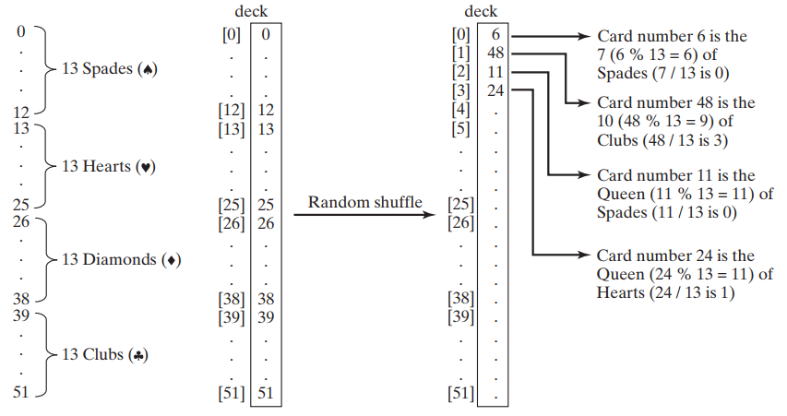
Case study: Deck of Cards

Slide 11
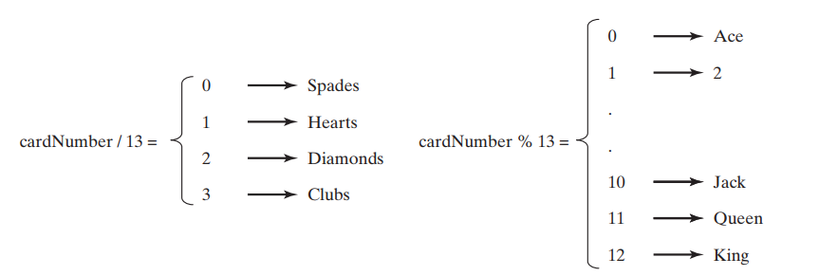
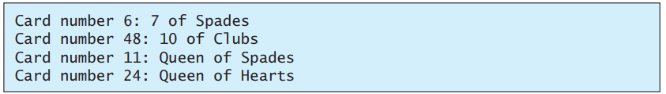
Case study: Deck of Cards
Notes:
int[] deck = new int[52]; String[] suits = {"Spades", "Hearts", "Diamonds", "Clubs"}; String[] ranks = {"Ace", "2", "3", "4", "5", "6", "7", "8", "9", "10", "Jack", "Queen", "King"}; // Initialize the cards for (int i = 0; i < deck.length; i++) deck[i] = i; // Shuffle the cards for (int i = 0; i < deck.length; i++) { // Generate an index randomly int index = (int)(Math.random() * deck.length); int temp = deck[i]; deck[i] = deck[index]; deck[index] = temp; } // Display the first four cards for (int i = 0; i < 4; i++) { String suit = suits[deck[i] / 13]; String rank = ranks[deck[i] % 13]; System.out.println("Card number " + deck[i] + ": " + rank + " of " + suit); }

Slide 12
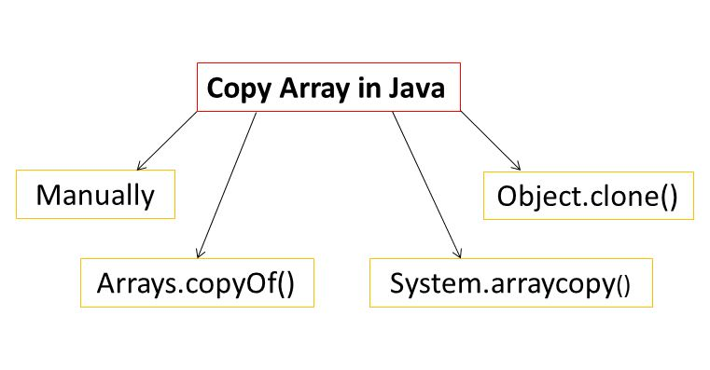
COPY ARRAYS
Notes:
package firstdemo;
import java.util.Arrays;
import java.util.Scanner;
public class Main {
public static void main(String[] args) {
// init an array
int sourceArr[] = {10,20,30,40,50};
System.out.println("Origin Arr: ");
printArr(sourceArr);
// manually copy
int equalArr[] = sourceArr;
System.out.println("Equal Arr: ");
printArr(equalArr);
int manualForArr[] = new int[sourceArr.length];
for (int i = 0; i < sourceArr.length; i++) {
manualForArr[i] = sourceArr[i];
}
System.out.println("Manually For Arr: ");
printArr(manualForArr);
// copyOf
int copyOfArr[] = new int[sourceArr.length];
copyOfArr = Arrays.copyOf(sourceArr, sourceArr.length);
System.out.println("Copy of Arr: ");
printArr(copyOfArr);
// array copy
int arrayCopyArr[] = new int[sourceArr.length];
System.arraycopy(sourceArr,0,arrayCopyArr,0,sourceArr.length);
System.out.println("Array copy Arr: ");
printArr(arrayCopyArr);
// clone
int cloneArr[] = new int[sourceArr.length];
cloneArr = sourceArr.clone();
System.out.println("Clone Arr: ");
printArr(cloneArr);
}
private static void printArr(int arr[]) {
for (int i = 0; i < arr.length; i++) {
System.out.print(arr[i]+" ");
}
System.out.println();
}
}

Slide 13
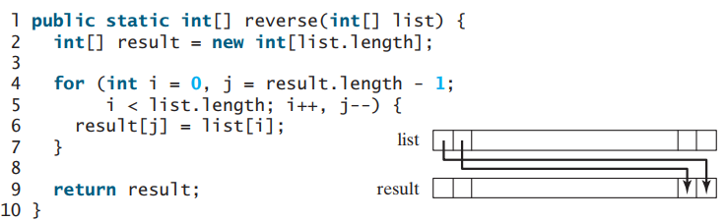
RETURN AN ARRAY FROM A METHOD

Slide 14
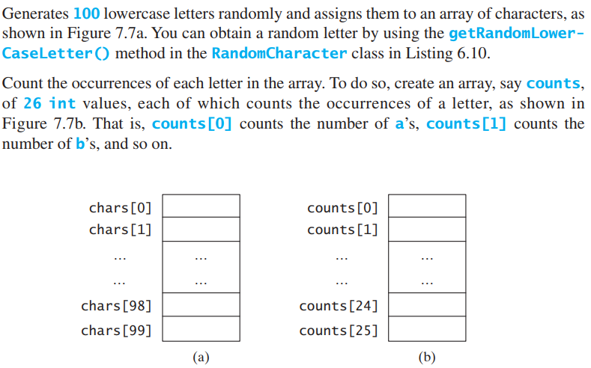
Case study: Occurrences of Each Letter
Notes:
package firstdemo;import java.util.Arrays;import java.util.Scanner;public class Main { public static void main(String[] args) { // Declare and create an array char[] chars = createArray(); // Display the array System.out.println("The lowercase letters are:"); displayArray(chars); // Count the occurrences of each letter int[] counts = countLetters(chars); // Display counts System.out.println(); System.out.println("The occurrences of each letter are:"); displayCounts(counts); } /** Create an array of characters */ public static char[] createArray() { // Declare an array of characters and create it char[] chars = new char[100]; // Create lowercase letters randomly and assign // them to the array for (int i = 0; i < chars.length; i++) chars[i] = RandomCharacter.getRandomLowerCaseLetter(); // Return the array return chars; } /** Display the array of characters */ public static void displayArray(char[] chars) { // Display the characters in the array 20 on each line for (int i = 0; i < chars.length; i++) { if ((i + 1) % 20 == 0) System.out.println(chars[i]); else System.out.print(chars[i] + " "); } } /** Count the occurrences of each letter */ public static int[] countLetters(char[] chars) { // Declare and create an array of 26 int int[] counts = new int[26]; // For each lowercase letter in the array, count it for (int i = 0; i < chars.length; i++) counts[chars[i] - 'a']++; return counts; } /** Display counts */ public static void displayCounts(int[] counts) { for (int i = 0; i < counts.length; i++) { if ((i + 1) % 10 == 0) System.out.println(counts[i] + " " + (char) (i + 'a')); else System.out.print(counts[i] + " " + (char) (i + 'a') + " "); } }}

Slide 15
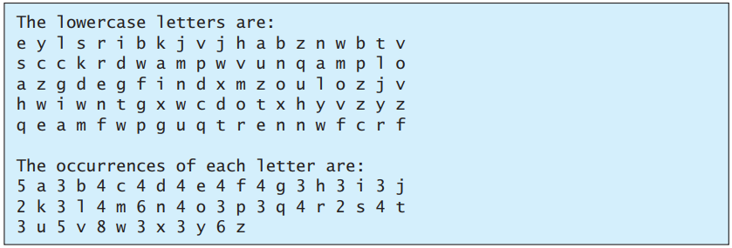
Case study: Occurrences of Each Letter

Slide 16
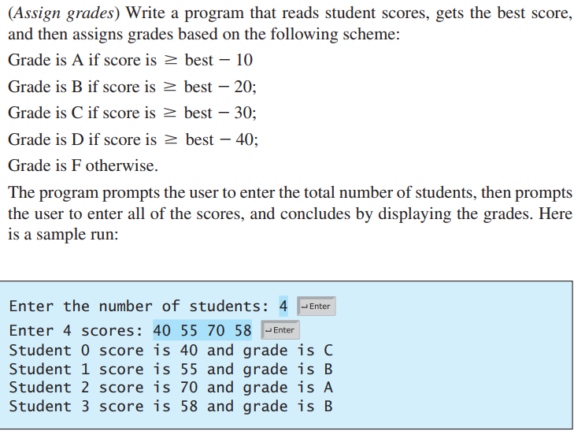
Exercise I

Slide 17
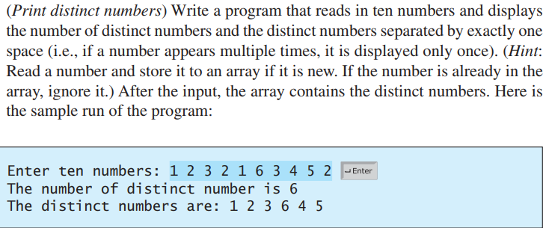
Exercise II

Slide 18
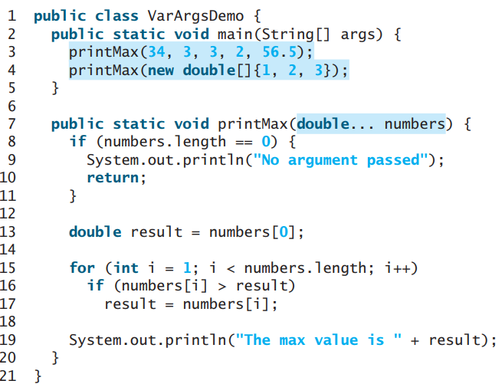
Variable-length Agrs List
Java treats a variable-length parameter as an array. You can pass an array or a variable number of arguments to a variable-length parameter. When invoking a method with a variable number of arguments, Java creates an array and passes the arguments to it
pass variable-length arg list
pass an array arg
a variable-length arg
parameter
Statements

Slide 19
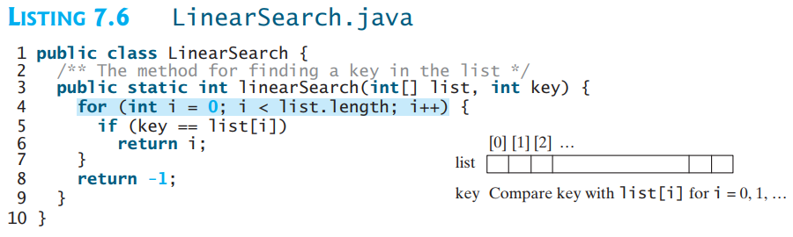
SEARCHING ARRAYS
Searching is the process of looking for a specific element in an array—for example, discovering whether a certain score is included in a list of scores. Searching is a common task in computer programming. Many algorithms and data structures are devoted to searching. This section discusses two commonly used approaches, linear search and binary search.

Slide 20
SEARCHING ARRAYS
Binary search is the other common search approach for a list of values. For binary search to work, the elements in the array must already be ordered. Assume that the array is in ascending order. The binary search first compares the key with the element in the middle of the array.
Consider the following three cases:
If the key is less than the middle element, you need to continue to search for the key only in the first half of the array.
If the key is equal to the middle element, the search ends with a match.
If the key is greater than the middle element, you need to continue to search for the key only in the second half of the array.

Slide 21
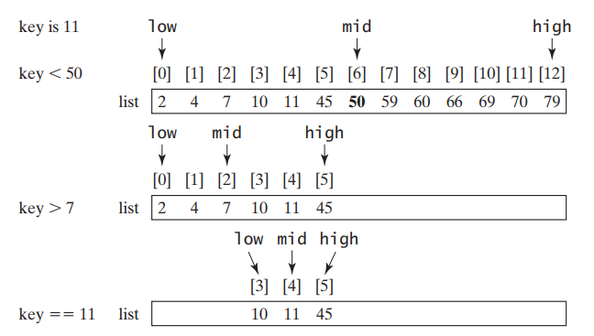
SEARCHING ARRAYS

Slide 22
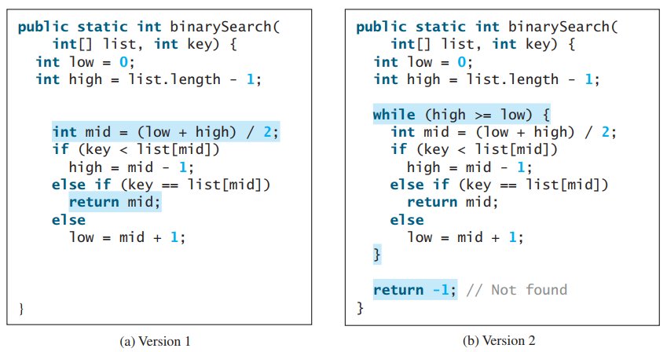
SEARCHING ARRAYS

Slide 23
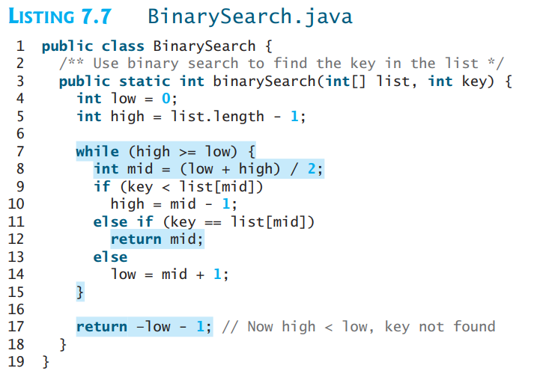
SEARCHING ARRAYS

Slide 24
SORTING ARRAYS
Sorting, like searching, is a common task in computer programming. Many different algorithms have been developed for sorting. This section introduces an intuitive sorting algorithm: Selection sort

Slide 25
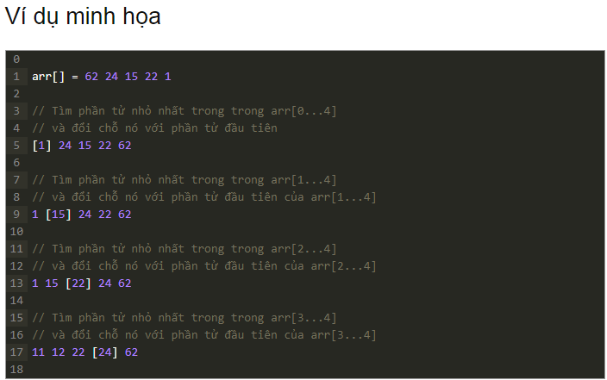
SORTING ARRAYS

Slide 26
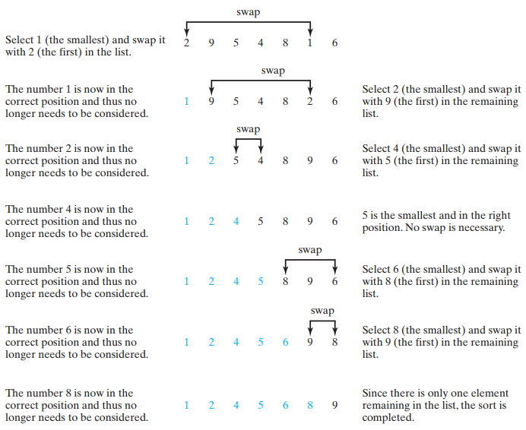
SORTING ARRAYS

Slide 27
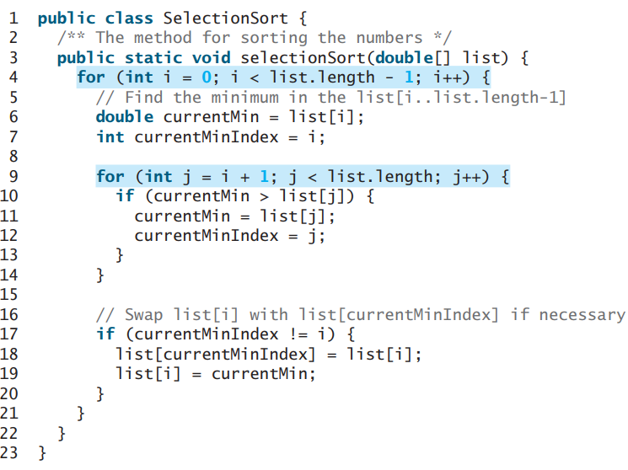
SORTING ARRAYS
Notes:
package firstdemo;
public class Main {
public static void main(String[] args) {
double list[] = {2.0, 1.3, 2.4, 5.6,3.5};
System.out.println("Before sort: ");
for (int i = 0; i < list.length; i++) {
System.out.print(list[i]+" ");
}
System.out.println();
selectionSort(list);
System.out.println("After sort: ");
for (int i = 0; i < list.length; i++) {
System.out.print(list[i]+" ");
}
}
public static void selectionSort(double[] list) {
for (int i = 0; i < list.length - 1; i++) {
// Find the minimum in the list[i..list.length-1]
double currentMin = list[i];
int currentMinIndex = i;
for (int j = i + 1; j < list.length; j++) {
if (currentMin > list[j]) {
currentMin = list[j];
currentMinIndex = j;
}
}
// Swap list[i] with list[currentMinIndex] if necessary
if (currentMinIndex != i) {
list[currentMinIndex] = list[i];
list[i] = currentMin;
}
}
}
}

Slide 28
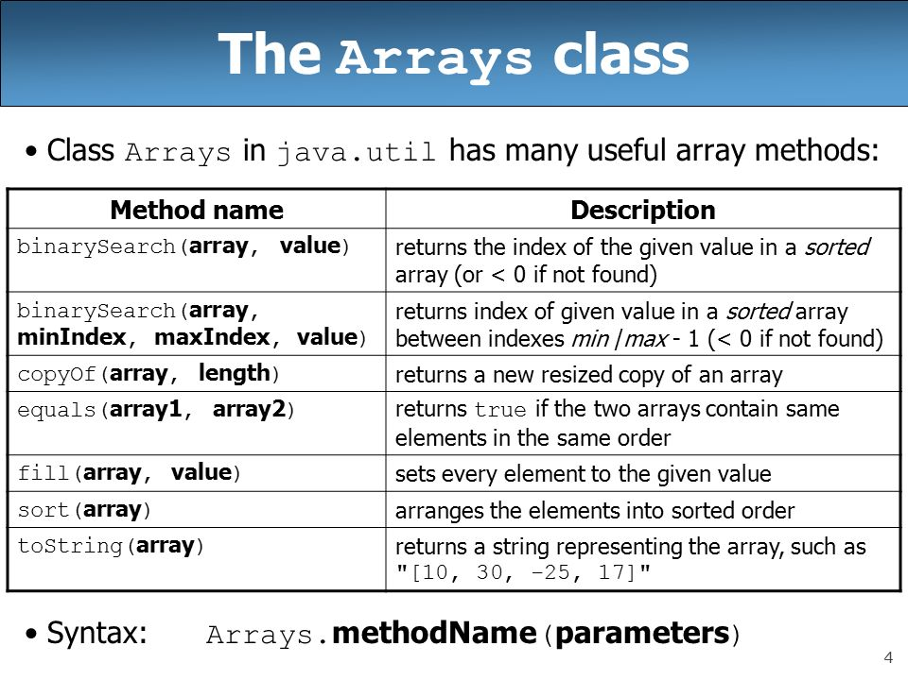
ARRAYS CLASS

Slide 29
EXERCISE I + II + III
(Sort students) Write a program that prompts the user to enter the number of students, the students’ names, and their scores, and prints student names in decreasing order of their scores.
(Bubble sort) Write a sort method that uses the bubble-sort algorithm. The Bubblesort algorithm makes several passes through the array. On each pass, successive neighboring pairs are compared. If a pair is not in order, its values are swapped; otherwise, the values remain unchanged. The technique is called a bubble sort or sinking sort because the smaller values gradually “bubble” their way to the top and the larger values “sink” to the bottom. Write a test program that reads in ten double numbers, invokes the method, and displays the sorted numbers.
(Sorted?) Write the following method that returns true if the list is already sorted in increasing order. Write a test program that prompts the user to enter a list and displays whether the list is sorted or not. Note that the first number in the input indicates the number of the elements in the list. This number is not part of the list.

Slide 30
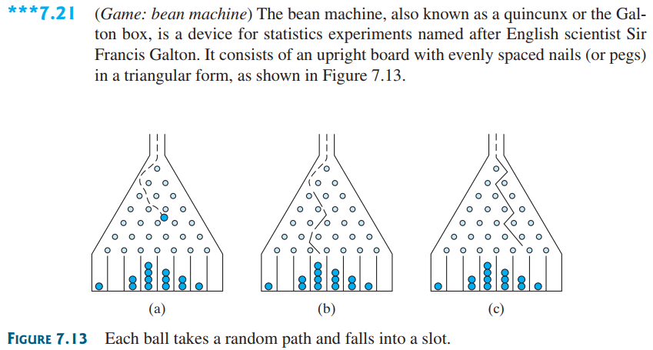
EXERCISE IV
***

Slide 31
EXERCISE IV
Balls are dropped from the opening of the board. Every time a ball hits a nail, it has a 50% chance of falling to the left or to the right. The piles of balls are accumulated in the slots at the bottom of the board.
Write a program that simulates the bean machine. Your program should prompt the user to enter the number of the balls and the number of the slots in the machine. Simulate the falling of each ball by printing its path. For example, the path for the ball in Figure 7.13b is LLRRLLR and the path for the ball in Figure 7.13c is RLRRLRR.
Display the final buildup of the balls in the slots in a histogram. Here is a sample run of the program.
(Hint: Create an array named slots. Each element in slots stores the number of balls in a slot. Each ball falls into a slot via a path. The number of Rs in a path is the position of the slot where the ball falls. For example, for the path LRLRLRR, the ball falls into slots[4], and for the path is RRLLLLL, the ball falls into slots[2].)

Slide 32
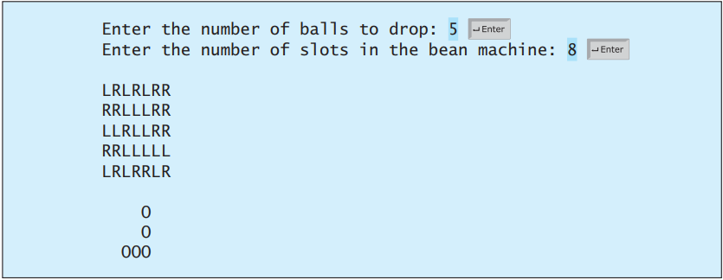
EXERCISE IV

Slide 33
EXERCISE IV

Slide 34
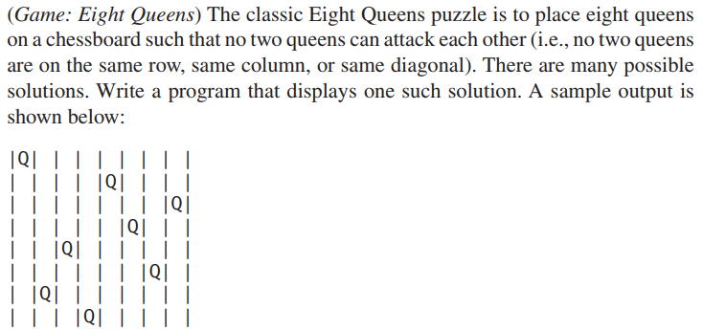
EXERCISE V

Slide 35
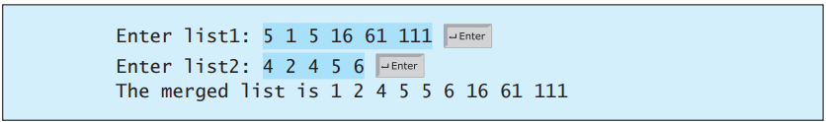
EXERCISE VI
(Merge two sorted lists) Write the following method that merges two sorted lists into a new sorted list.
public static int[] merge(int[] list1, int[] list2)
Implement the method in a way that takes at most list1.length + list2.length comparisons. Write a test program that prompts the user to enter two sorted lists and displays the merged list. Here is a sample run. Note that the first number in the input indicates the number of the elements in the list. This number is not part of the list.

Slide 36
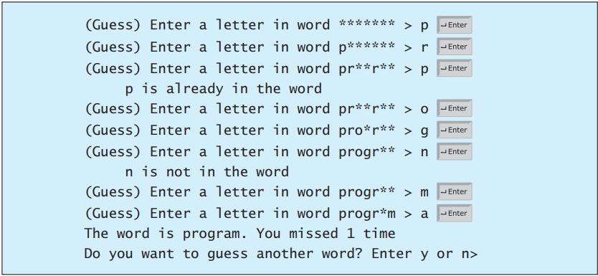
EXERCISE VII
(Game: hangman) Write a hangman game that randomly generates a word and prompts the user to guess one letter at a time, as shown in the sample run. Each letter in the word is displayed as an asterisk. When the user makes a correct guess, the actual letter is then displayed. When the user finishes a word, display the number of misses and ask the user whether to continue to play with another word. Declare an array to store words, as follows: String[] words = {"write", "that", ...};

Slide 37
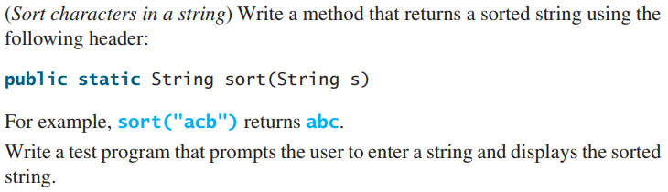
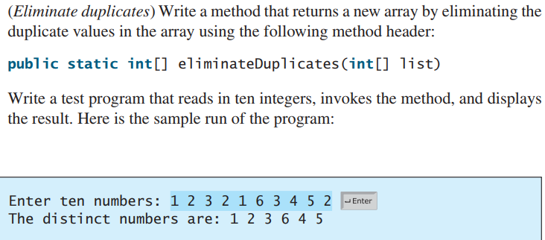
EXERCISE VIII + IX

Slide 38
EXERCISE X
Write a Java program to find the common elements between two arrays, using override methods for String, integer then do these tasks:
If they’re integers:
Remove duplicated elements from two arrays then sort them
Find out the second largest element and the second smallest one after merging two sorted array.
Compute the average value of merged array except the second largest and smallest values
Split the merged array into two small arrays: the even and odd ones
If they’re strings:
Remove duplicated elements from two arrays
Merge two arrays without duplicated ones
Sort the merged array in ascending order and descending order

